Slide 1
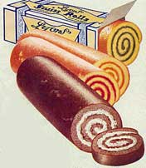
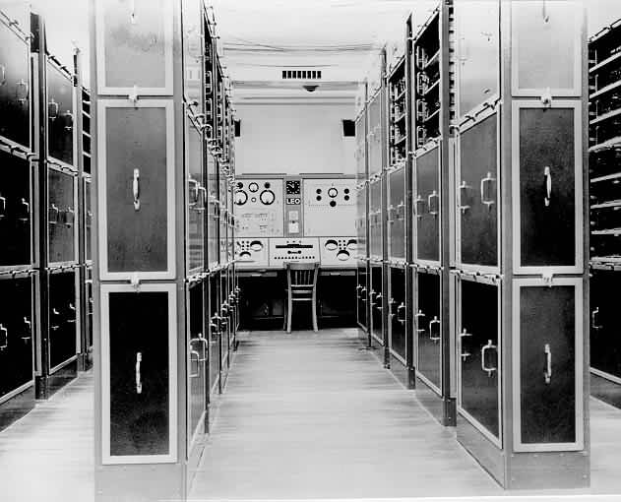
CAKES TO COMPUTERS
LEO
THE WORLD’S
FIRST
BUSINESS COMPUTER

Slide 2
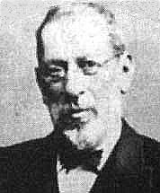
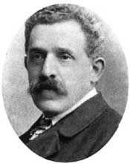
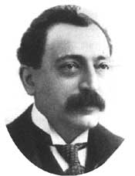
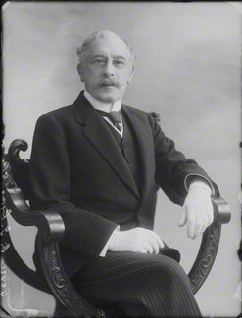
Barnett Salmon Isidore Gluckstein Montague Gluckstein
Joseph Lyons

Slide 3
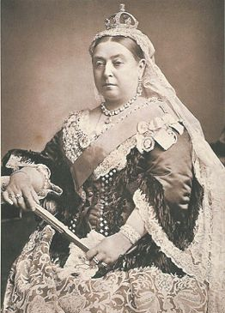
1887: Queen Victoria’s Golden Jubilee Year
Newcastle Jubilee Exhibition

Slide 4
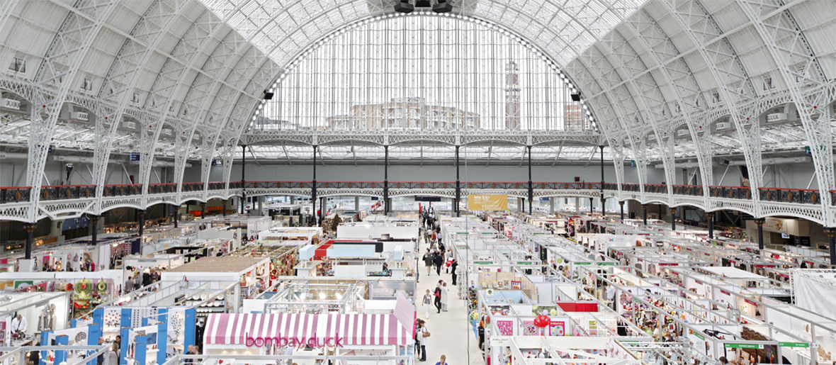
Grand Hall, Olympia

Slide 5
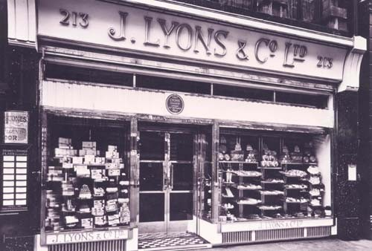
213 Piccadilly, The First Lyons Teashop (1894-1976)

Slide 6
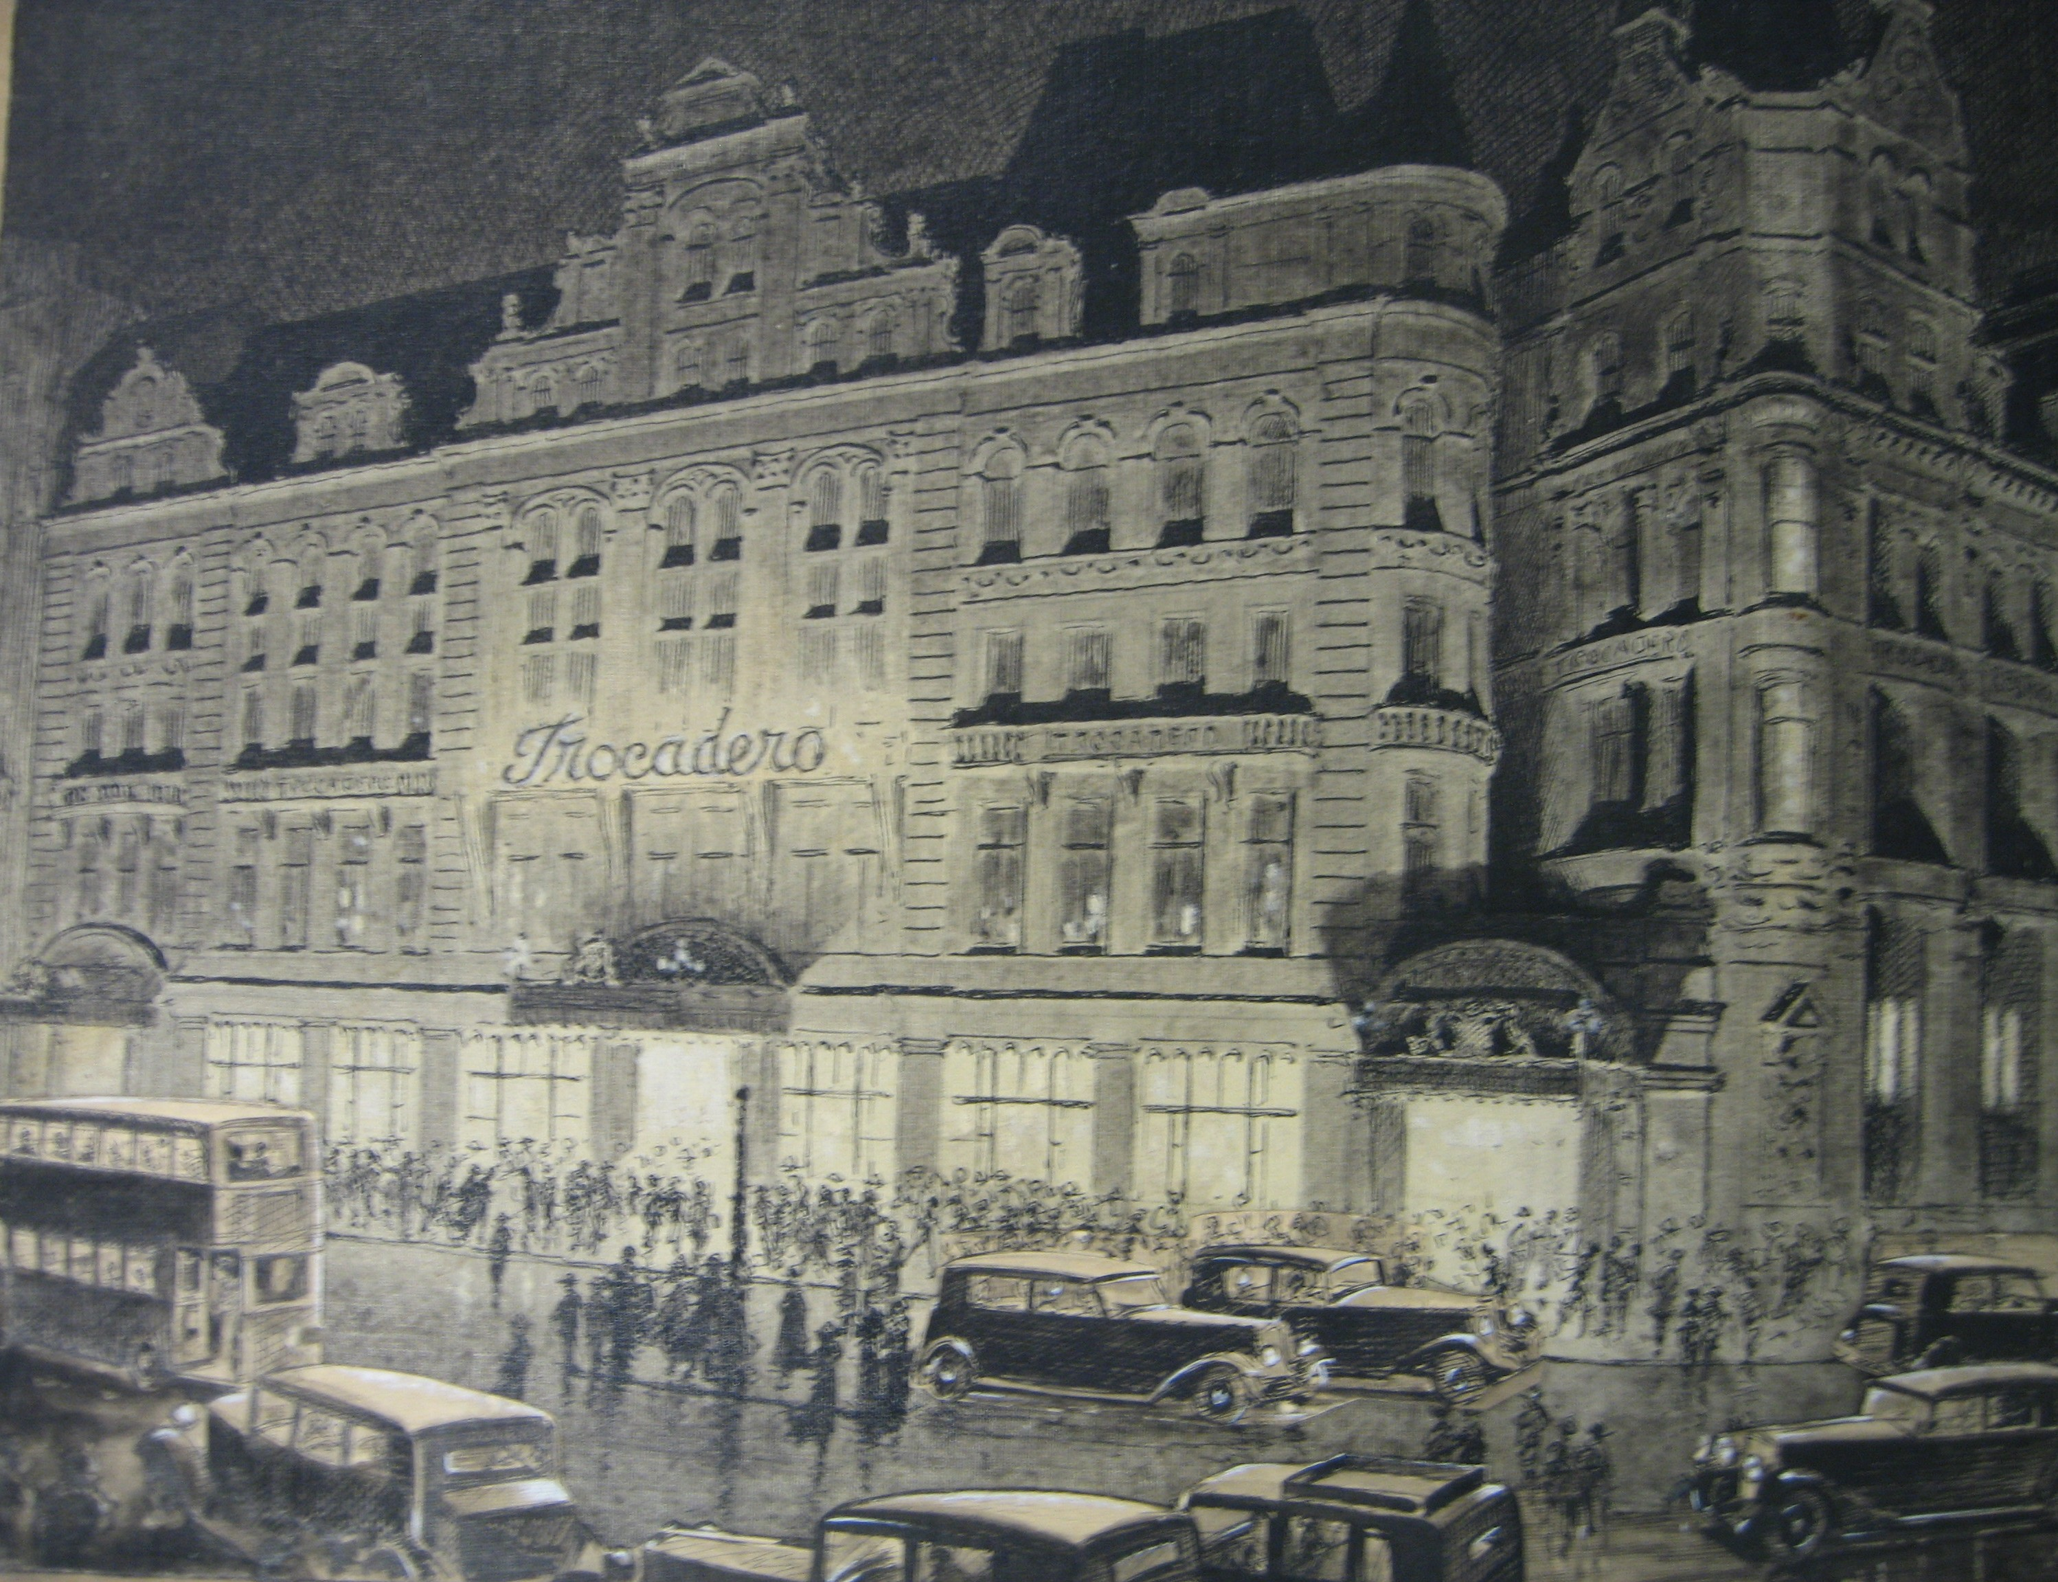
The Trocadero 1896-1965

Slide 7
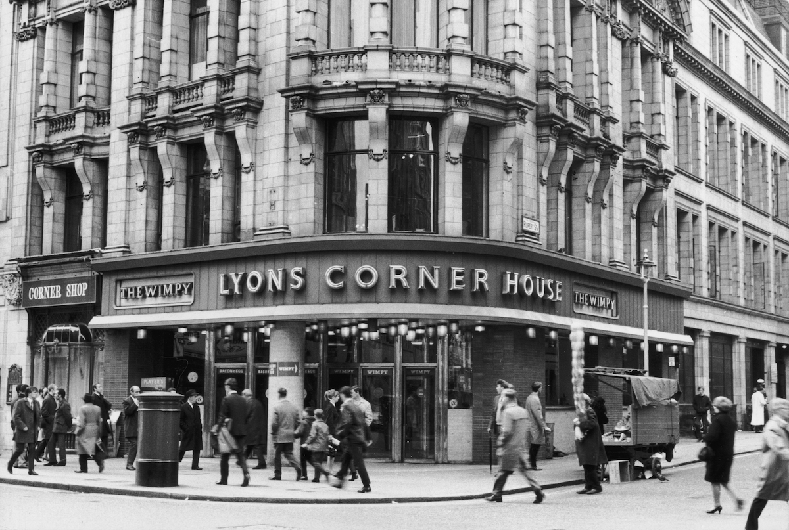
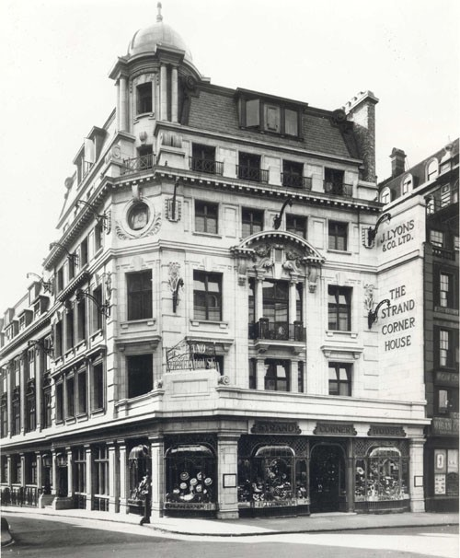
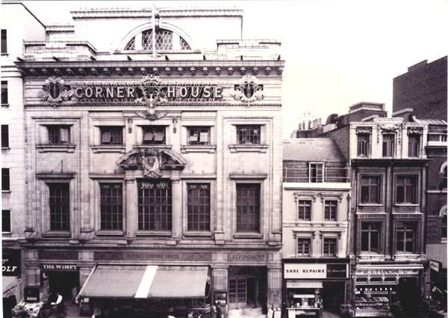
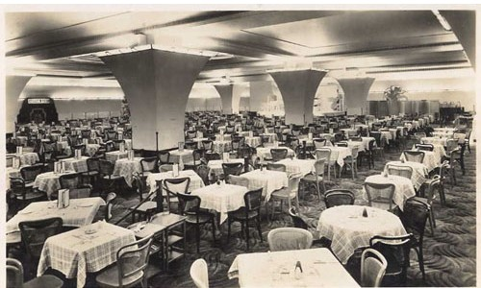
Coventry Street 1909-70 The Strand 1915-77
The Lyons Corner Houses
Oxford Street 1928-67 Marble Arch 1933-77

Slide 8
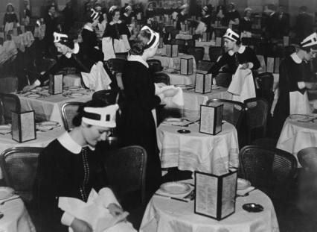
Nippy Waitresses Preparing Tables

Slide 9
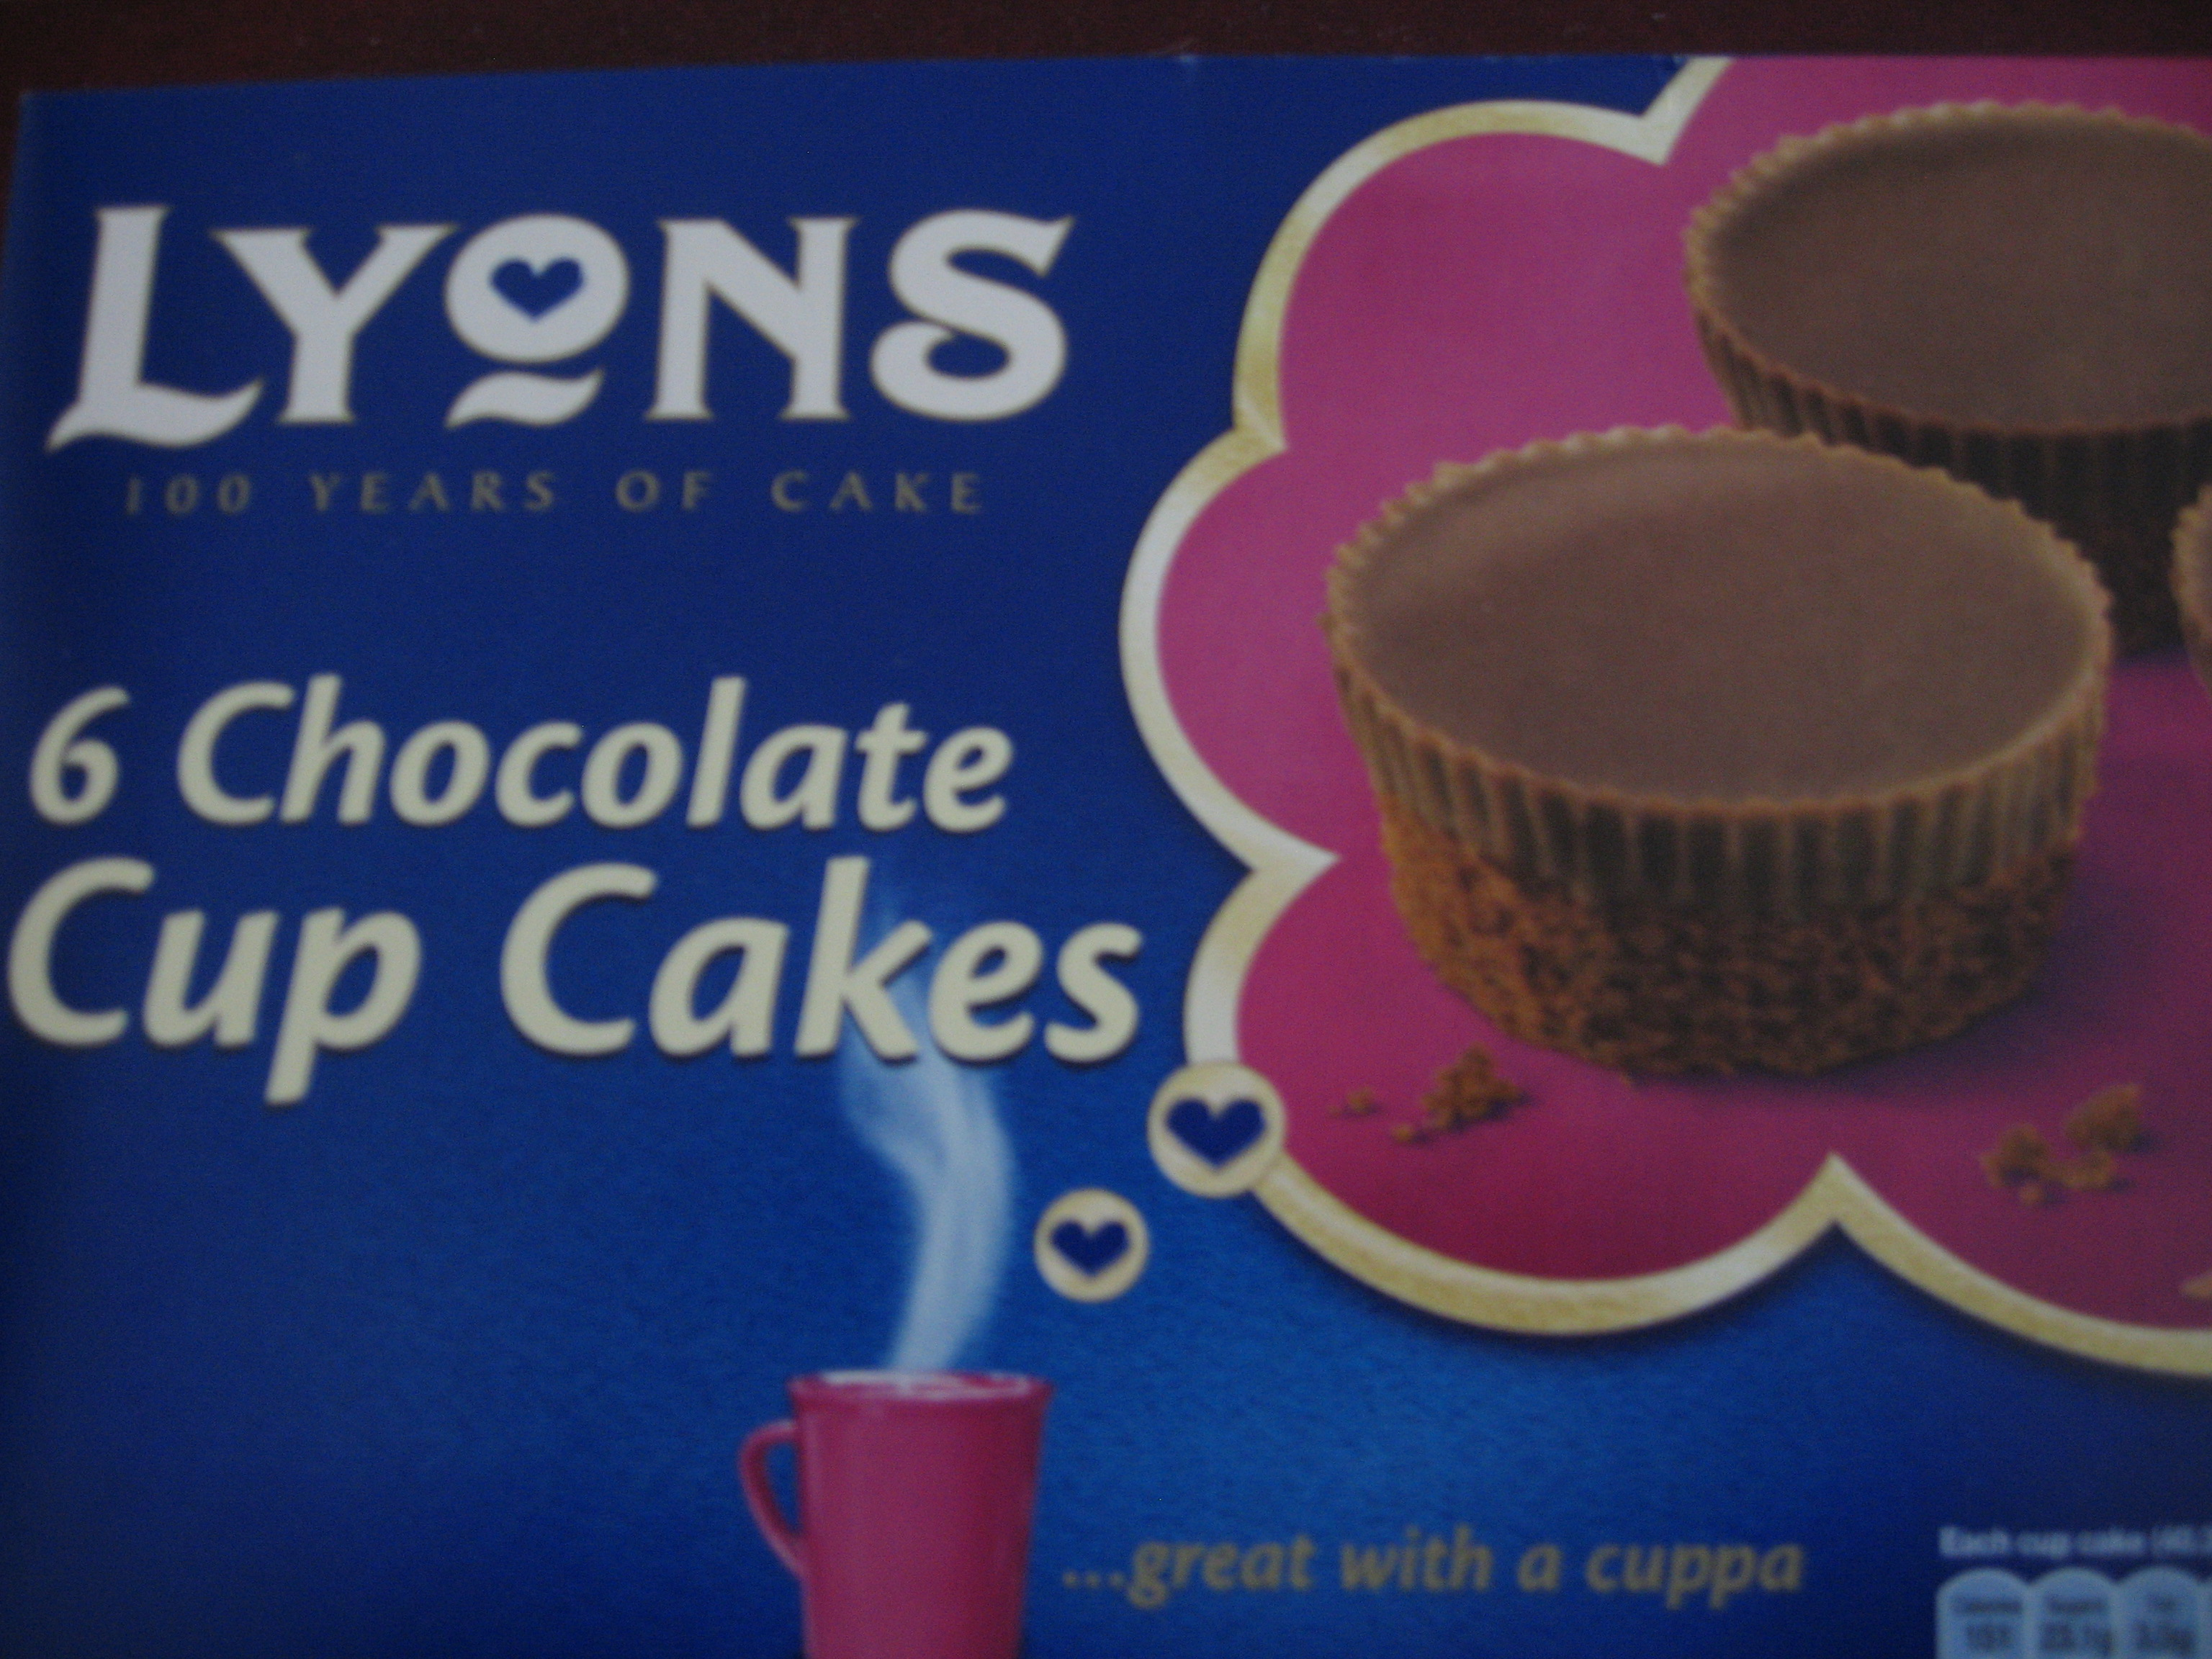
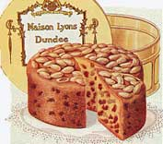
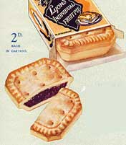

Slide 10
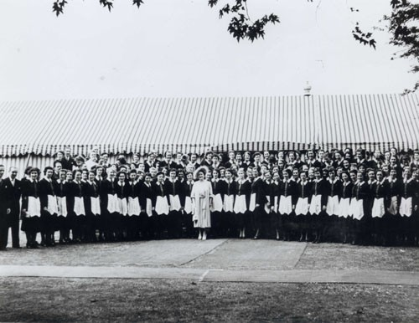
A Royal Garden Party, July 1951
One of the many Royal Garden Parties run by J Lyons & Co

Slide 11
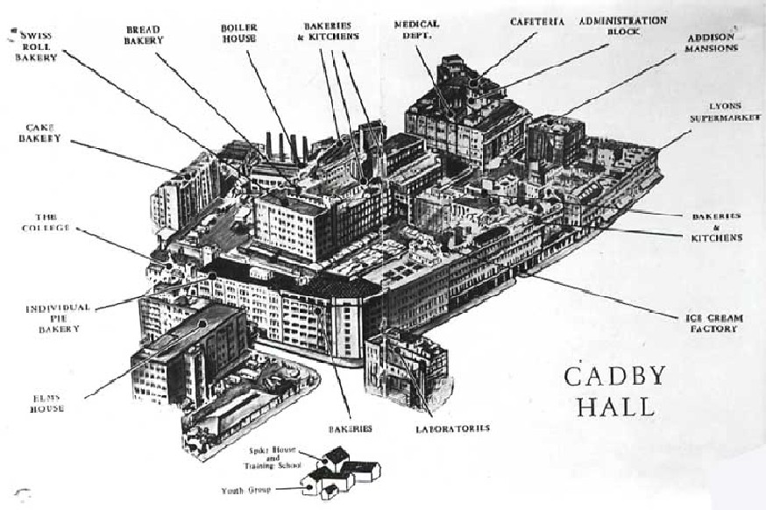

Slide 12
J Lyons & Co A Flair for ACHIEVING THE SEEMINGLY IMPOSSIBLE!

Slide 13
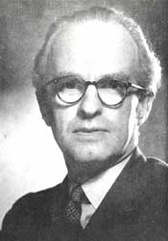
John Simmons

Slide 14
SYSTEMS RESEARCH MANAGER
John Simmons

Slide 15
CHIEF COMPTROLLER, J LYONS & CO
John Simmons

Slide 16
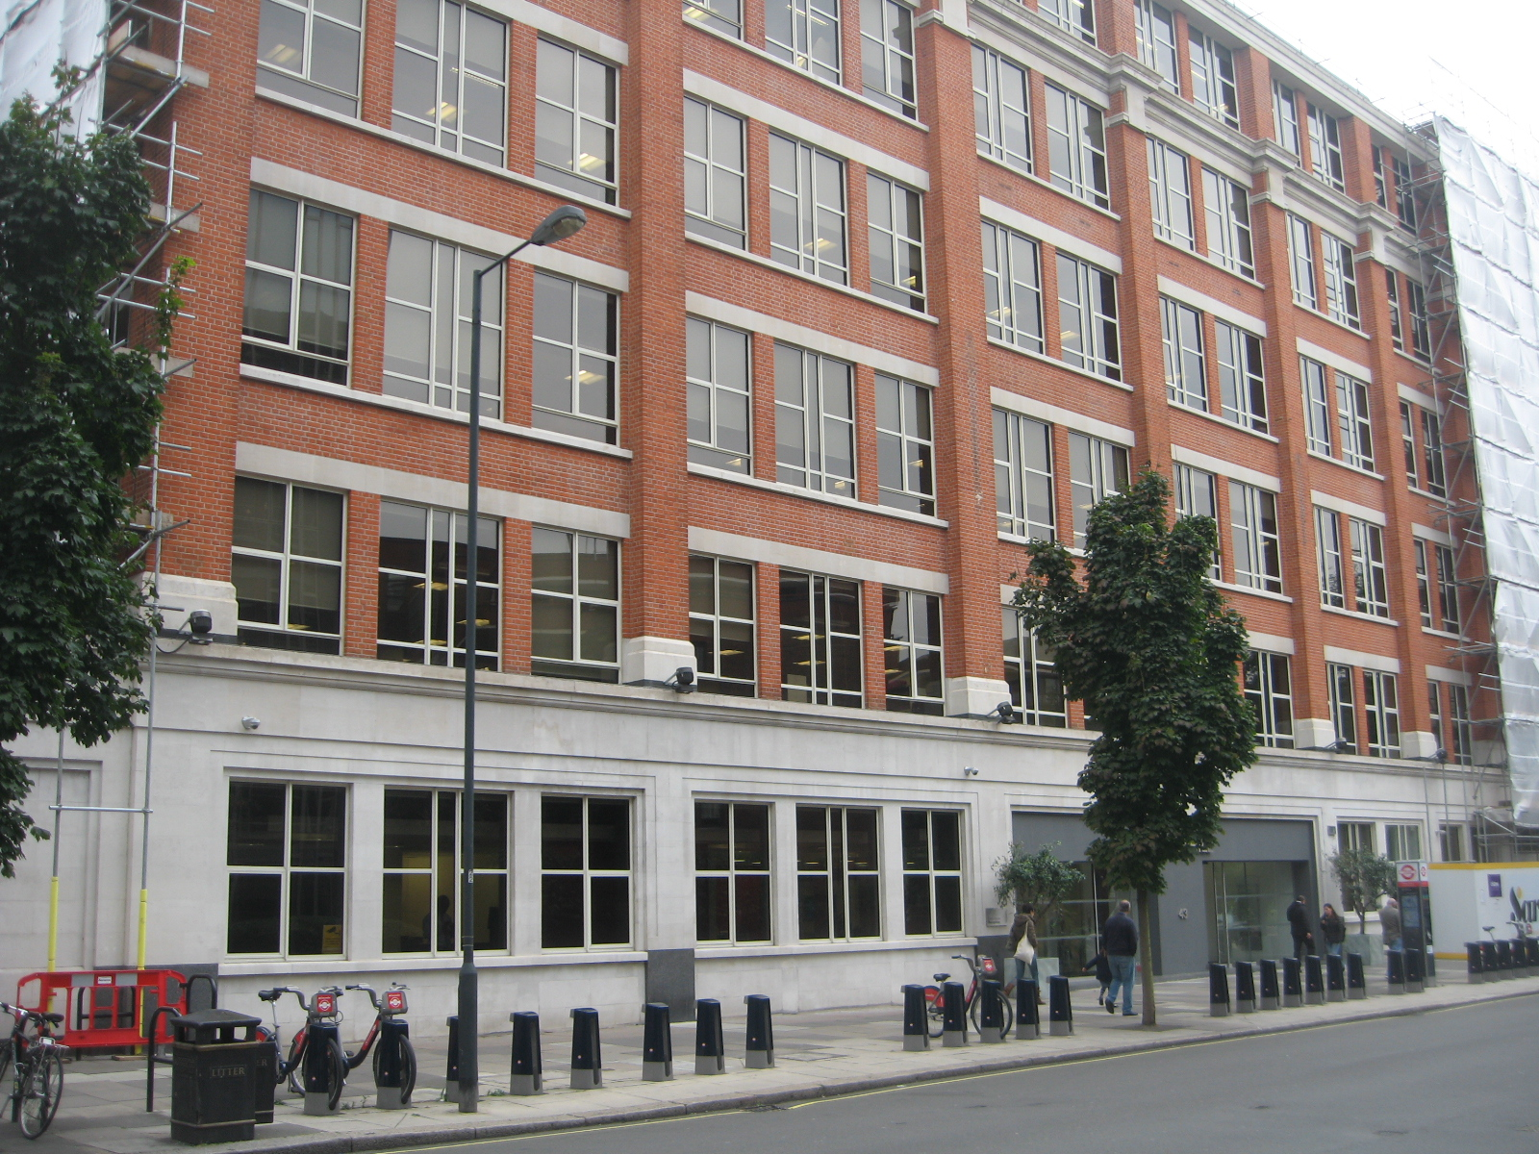

Slide 17
Computer Survey of the USA
T R Thompson
Oliver Standingford

Slide 18
There are those who do not believe in the desirability of introducing anything as esoteric as electronics into business routine. The Economist

Slide 19
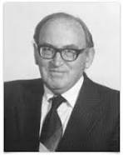
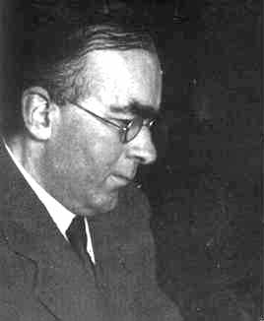
THE CAMBRIDGE PROJECT EDSAC Electronic Delay Automatic Storage Calculator
Professor Douglas Hartree Dr. Maurice Wilkes

Slide 20
THE COMPANY “Can Do” PRINCIPLE

Slide 21
LYONS ELECTRONIC OFFICE

Slide 22
Advert in Scientific Journal Nature 1948: Wanted: A qualified engineer with experience of television design and ultra high frequency techniques

Slide 23
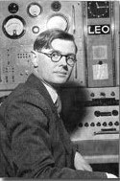
LEO CHIEF ENGINEER
Dr John Pinkerton

Slide 24
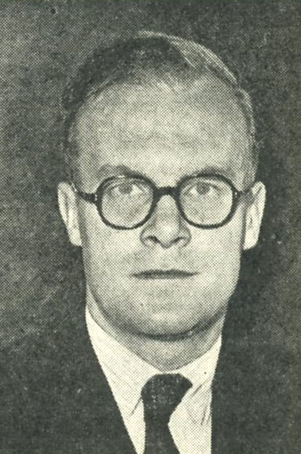
LEO PROJECT MANAGEMENT
TR Thompson

Slide 25
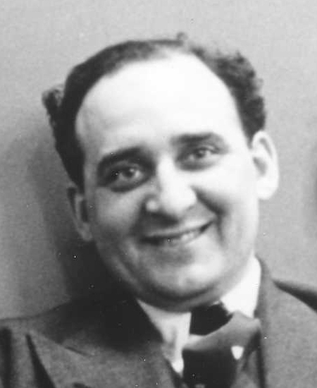
LEO OPERATIONAL DEVELOPMENT
David Caminer

Slide 26
LEO 1 : Cadby Hall, 1951

Slide 27
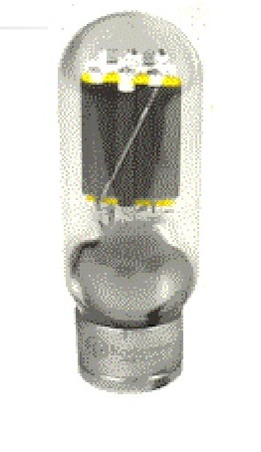
Computer Vacuum Tube

Slide 28
LEO 1 : Cadby Hall, 1951

Slide 29
FIRST OPERATIONAL PROGRAM
November 1951
BAKERY VALUATIONS

Slide 30
SECOND OPERATIONAL PROGRAM
December 1953
COMPANY PAY ROLL

Slide 31
BUREAU ACTIVITY INLAND REVENUE: TAX TABLES

Slide 32
MORE BUREAU ACTIVITIES INLAND REVENUE: TAX TABLES MET OFFICE: WEATHER FORECASTING

Slide 33
Now for LEO II………

Slide 34
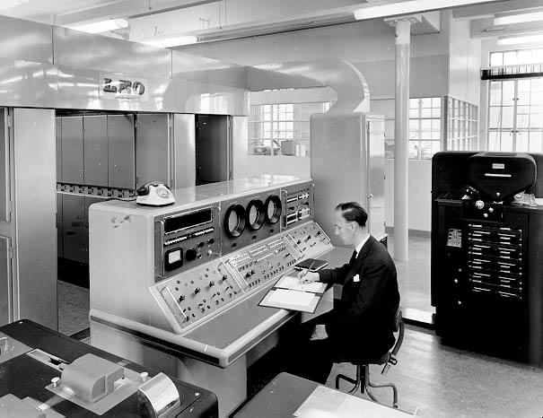
LEO II at Elms House, Cadby Hall

Slide 35
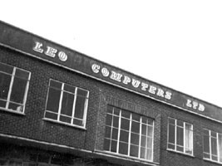
Minerva Road, Acton

Slide 36
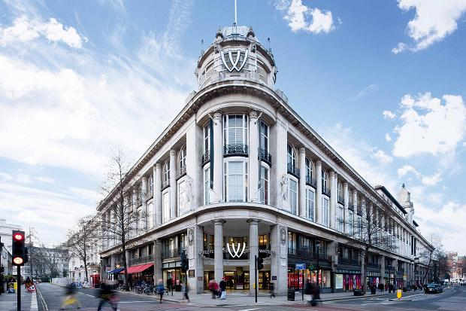
Whiteleys Department Store, Bayswater
LEO II BUREAU, HARTREE HOUSE

Slide 37
LEO II BUREAU ACTIVITIES Pay Rolls for FORD MOTOR CO

Slide 38
LEO II BUREAU ACTIVITIES Pay Rolls for FORD MOTOR CO KODAK

Slide 39
LEO II BUREAU ACTIVITIES Pay Rolls for FORD MOTOR CO KODAK TATE & LYLE

Slide 40
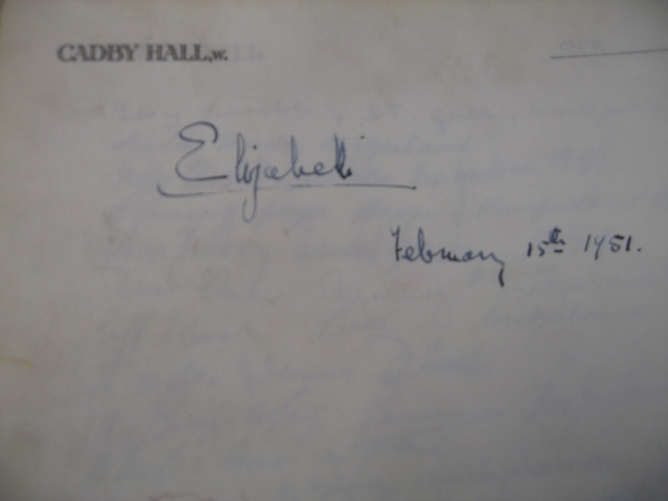
Princess Elizabeth visits Cadby Hall, 15th February 1951

Slide 41
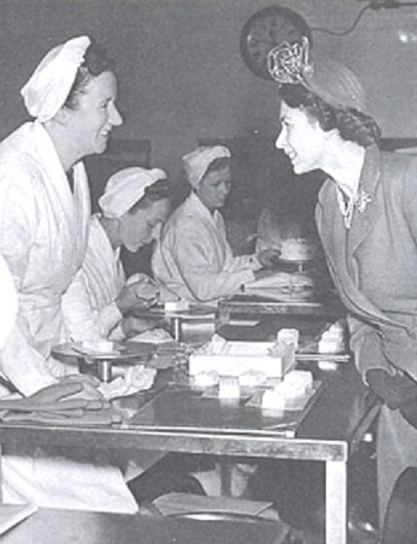
Princess Elizabeth visits Cadby Hall, Bakery Department 15th FebruPary 1951

Slide 42
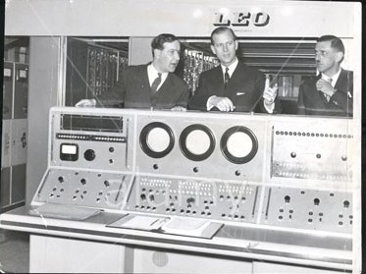
The Duke of Edinburgh visits Leo Computers Ltd,1960

Slide 43
SALES OF LEO II WD & HO WILLS (2 LEOs) BRITISH OXYGEN MINISTRY OF PENSIONS & NATIONAL INSURANCE STANDARD MOTOR CO FORD MOTOR CO (2 LEOs) ILFORD FILMS STEWARTS & LLOYDS

Slide 44
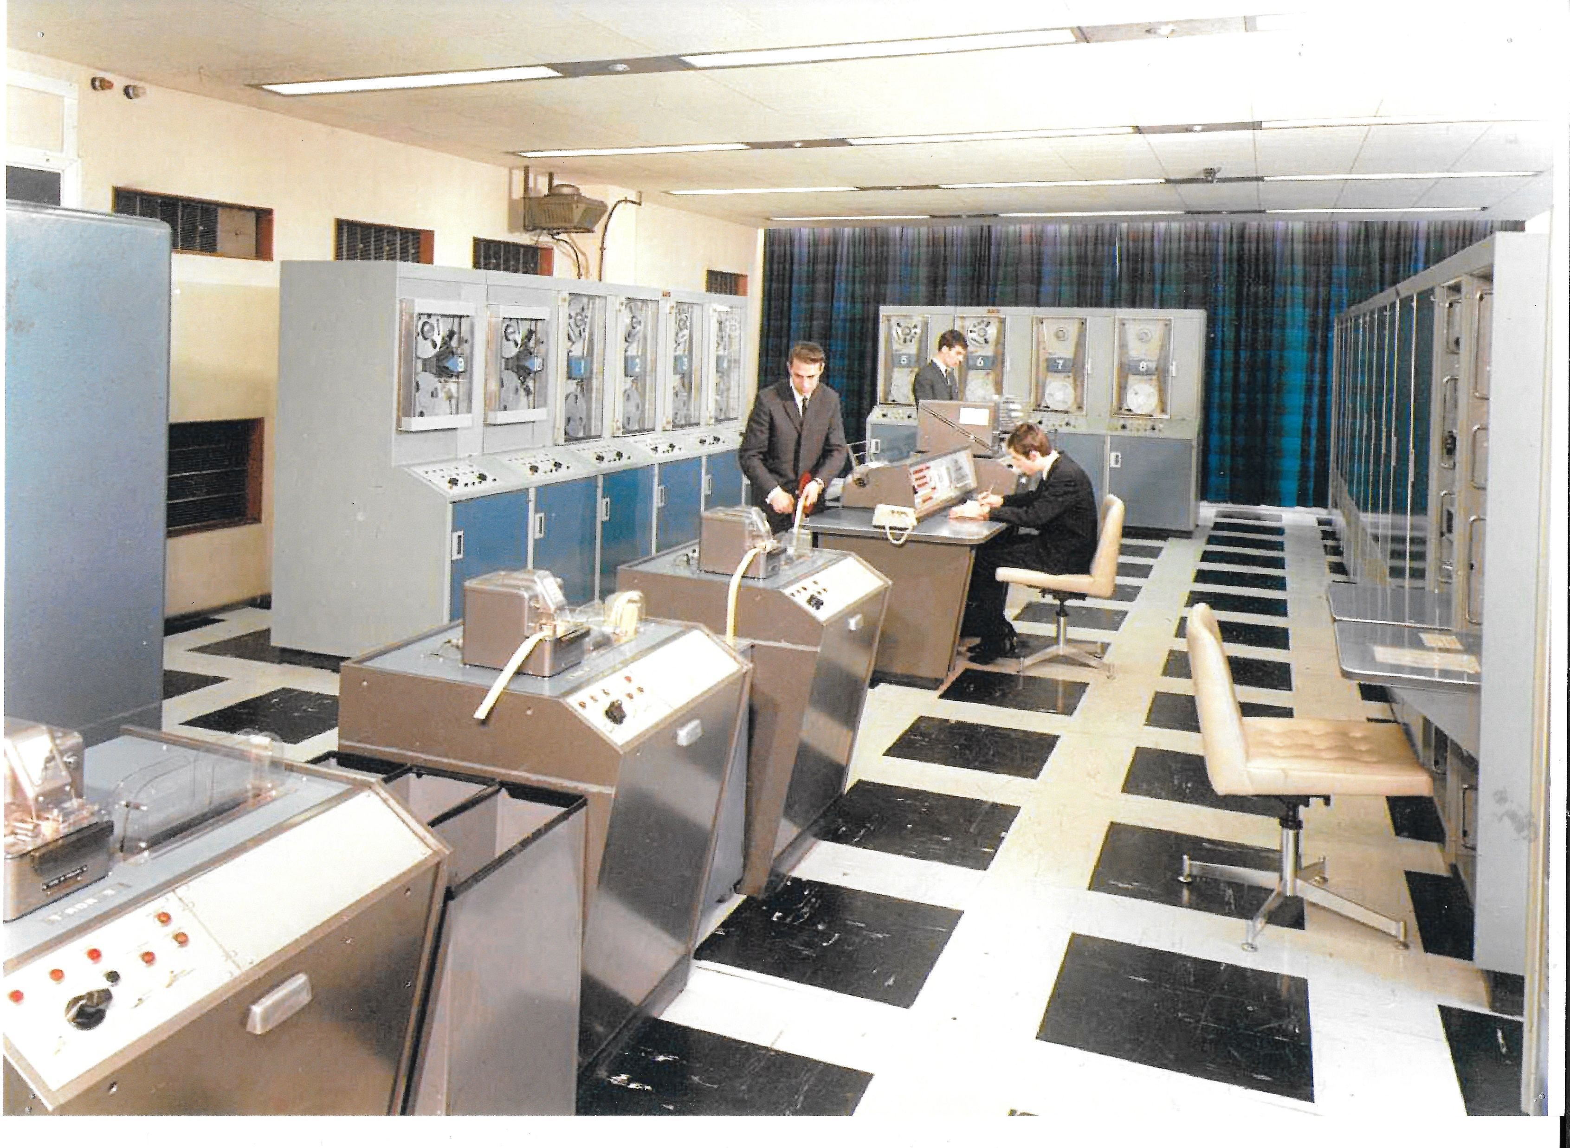
LEO III at Elms House, Cadby Hall, 1962

Slide 45
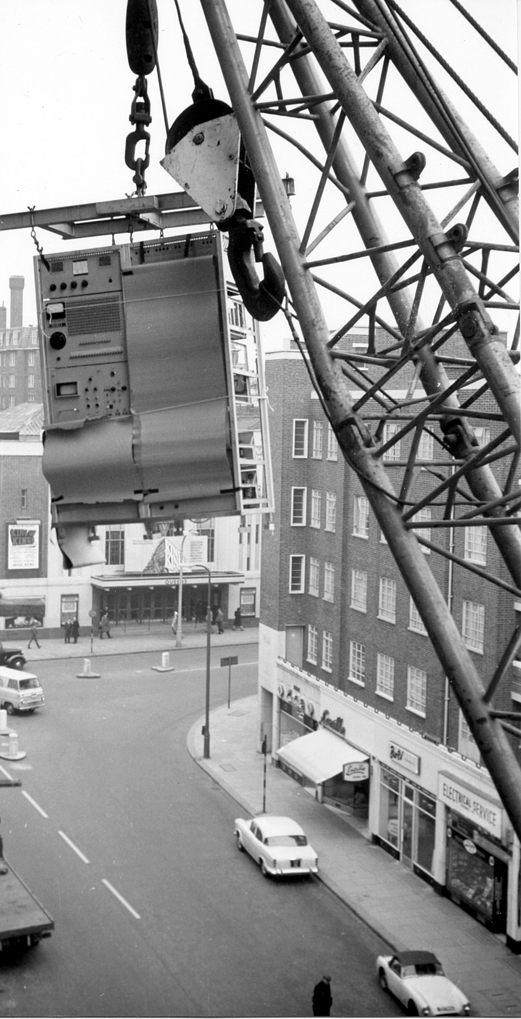
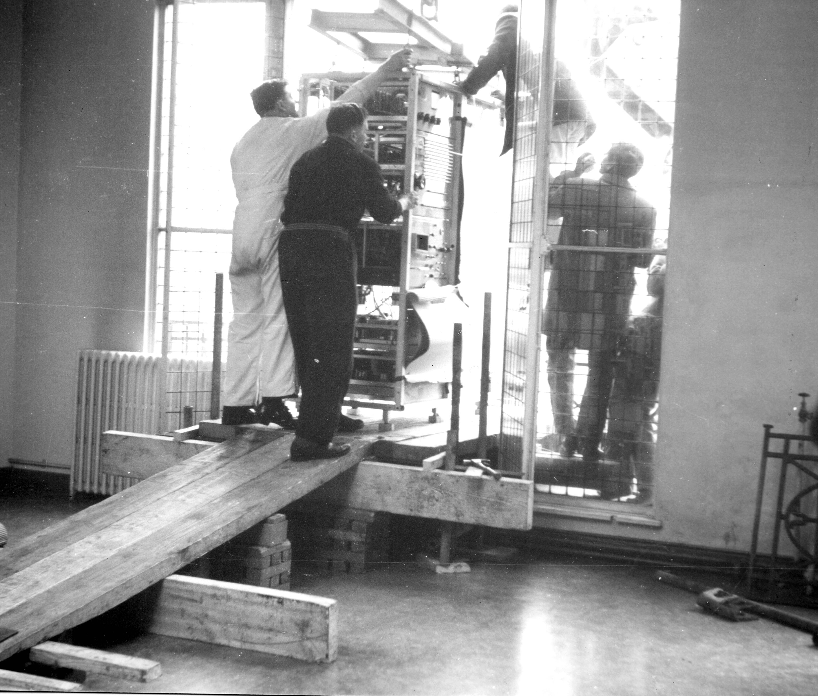
Hartree House Whiteleys Department Store,Bayswater
LEO III arrives at the Bureau

Slide 46
SALES OF LEO III 58 LEOs including: DUNLOP RUBBER BRITISH OXYGEN SHELL MEX AND BP ROYAL BANK OF SCOTLAND CEREBOS HJ HEINZ EVER READY KAYSER-BONDOR TOTE INVESTORS SOUTH-WESTERN GAS BOARD BOARD OF TRADE INLAND REVENUE CUSTOMS AND EXCISE HM DOCKYARDS (4 LEOs) GENERAL POST OFFICE (14 LEOs)

Slide 47
OVERSEAS SALES OF LEO III
SOUTH AFRICA
RAND GOLD MINING
CONSOLIDATED GLASS

Slide 48
OVERSEAS SALES OF LEO III
SOUTH AFRICA
RAND GOLD MINING
CONSOLIDATED GLASS
AUSTRALIA
SHELL GROUP (2 LEOs)
TUBEMAKERS LTD
COLONIAL MUTUAL LIFE

Slide 49
OVERSEAS SALES OF LEO III
SOUTH AFRICA
RAND GOLD MINING
CONSOLIDATED GLASS
AUSTRALIA
SHELL GROUP (2 LEOs)
TUBEMAKERS LTD
COLONIAL MUTUAL LIFE
CZECHOSLOVAKIA
STATE RAILWAYS
KLEMENTA STEEL WORKS
SOCIAL SECURITY OFFICE

Slide 50
COMPETITION and SETBACKS

Slide 51
1960’S COMPETITOR MANUFACTURERS
English Electric
EMI
Marconi
Ferranti
Standard Telephones & Cables
Elliott Automation
ICT
IBM

Slide 52
LEO and Industry Mergers: 1963-2002
1954 LEO Computers Ltd formed

Slide 53
LEO and Industry Mergers: 1963-2002
1954 LEO Computers Ltd formed
1963 Merger with English Electric = English Electric LEO Computers

Slide 54
LEO and Industry Mergers: 1963-2002
1954 LEO Computers Ltd formed
1963 Merger with English Electric = English Electric LEO Computers
1964 Merger with Marconi Computers = English Electric LEO Marconi
Computers

Slide 55
LEO and Industry Mergers: 1963-2002
1954 LEO Computers Ltd formed
1963 Merger with English Electric = English Electric LEO Computers
1964 Merger with Marconi Computers = English Electric LEO Marconi
Computers
1967 Take-over of Elliott Automation = English Electric Computers

Slide 56
LEO and Industry Mergers: 1963-2002
1954 LEO Computers Ltd formed
1963 Merger with English Electric = English Electric LEO Computers
1964 Merger with Marconi Computers = English Electric LEO Marconi
Computers
1967 Take-over of Elliott Automation = English Electric Computers
1968 Government-sponsored merger with ICT= ICL

Slide 57
LEO and Industry Mergers: 1963-2002
1954 LEO Computers Ltd formed
1963 Merger with English Electric = English Electric LEO Computers
1964 Merger with Marconi Computers = English Electric LEO Marconi
Computers
1967 Take-over of Elliott Automation = English Electric Computers
1968 Government-sponsored merger with ICT= ICL
2002 ICL merger into Fujitsu Siemens Computers

Slide 58
CADBY HALL 1951: LEO 1 IS BORN 1965: LEO 1 RETIRED

Slide 59
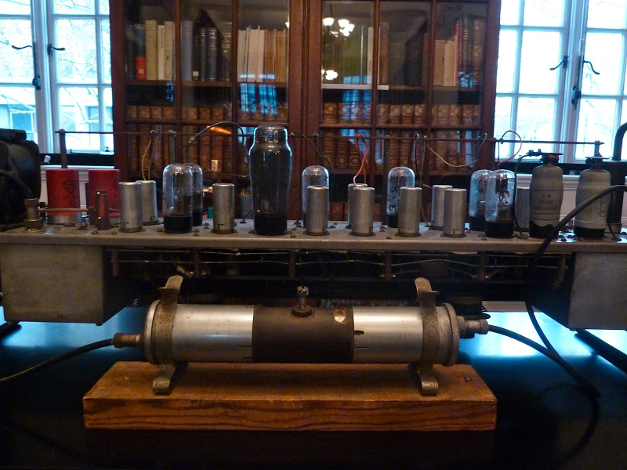
LEO AND THE INFORMATION AGE
The Remains of LEO 1

Slide 60
END OF AN ERA……..

Slide 61
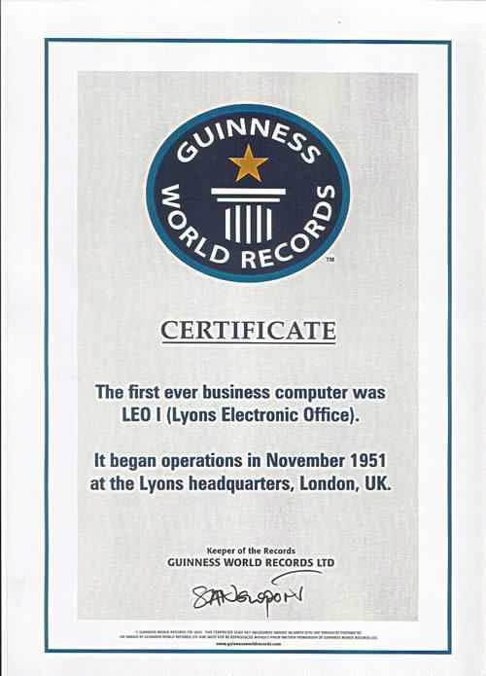

Slide 62
LEO COMPUTERS SOCIETY
Guardian of the History of LEO
http://www.leo-computers.org.uk/

Slide 63
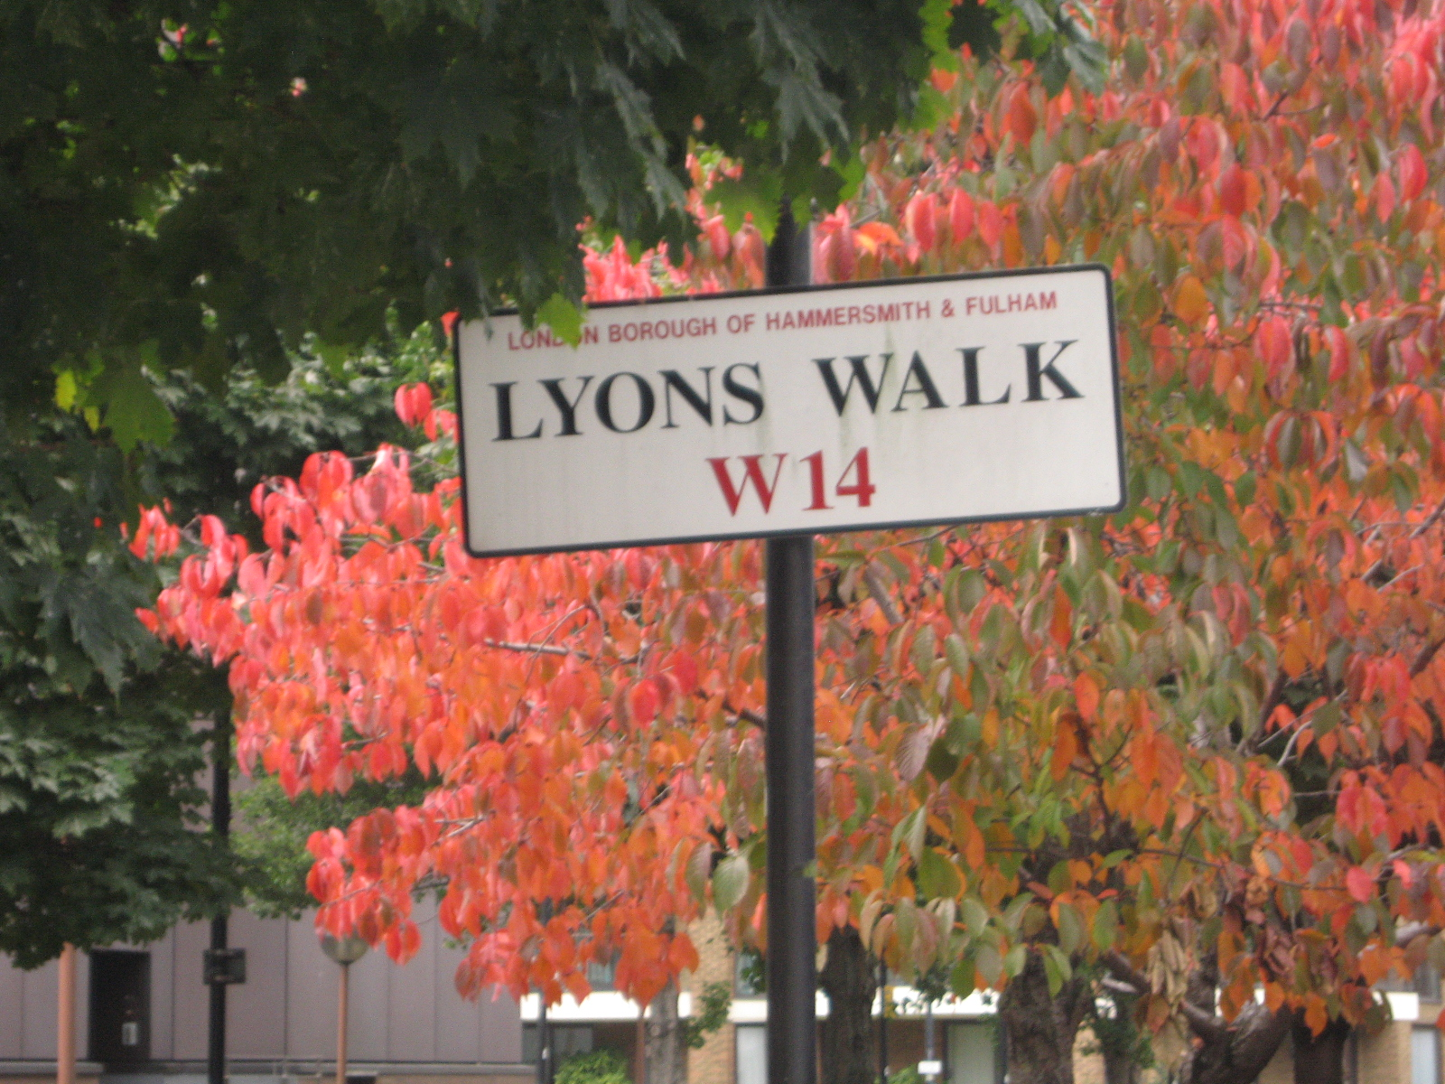
Site for LEO Memorial plaque

Slide 65
Swiss Rolls, Tea and the Electronic Office
A History of LEO, the World’s First Business Computer
Project Funded by the National Heritage Lottery
Undertaken by LEO Computers Society and Centre for Computing History, Cambridge

Slide 66
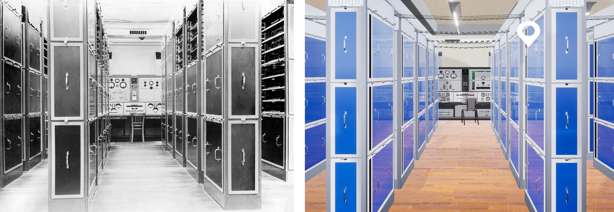
LEO 1 Virtual Reality

Slide 67
LEO TO THE YOUNGER GENERATIONS

Slide 68
FILM ”LEO: The Story of the World’s First Business Computer”

Slide 69
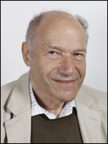
Frank Land, OBE: An Original Programmer

Slide 70
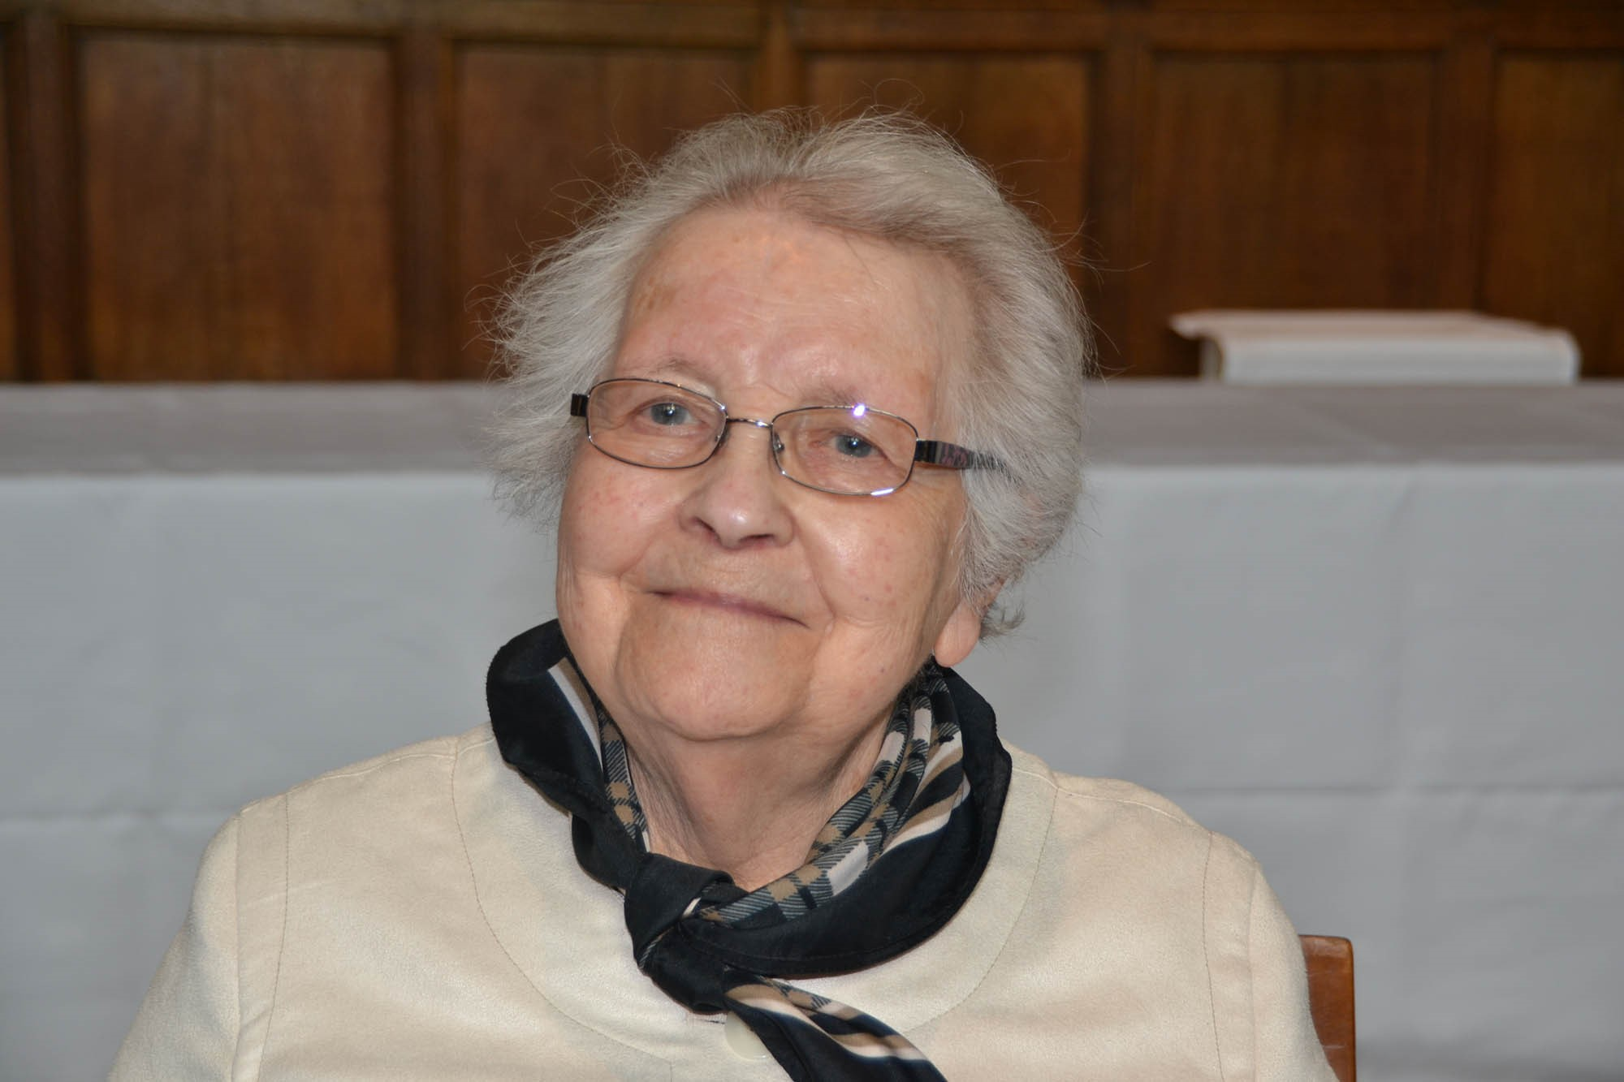
Mary Coombs: 1st Female Programmer

Slide 71
FILM ”LEO: The Story of the World’s First Business Computer” Link To Video

Slide 72
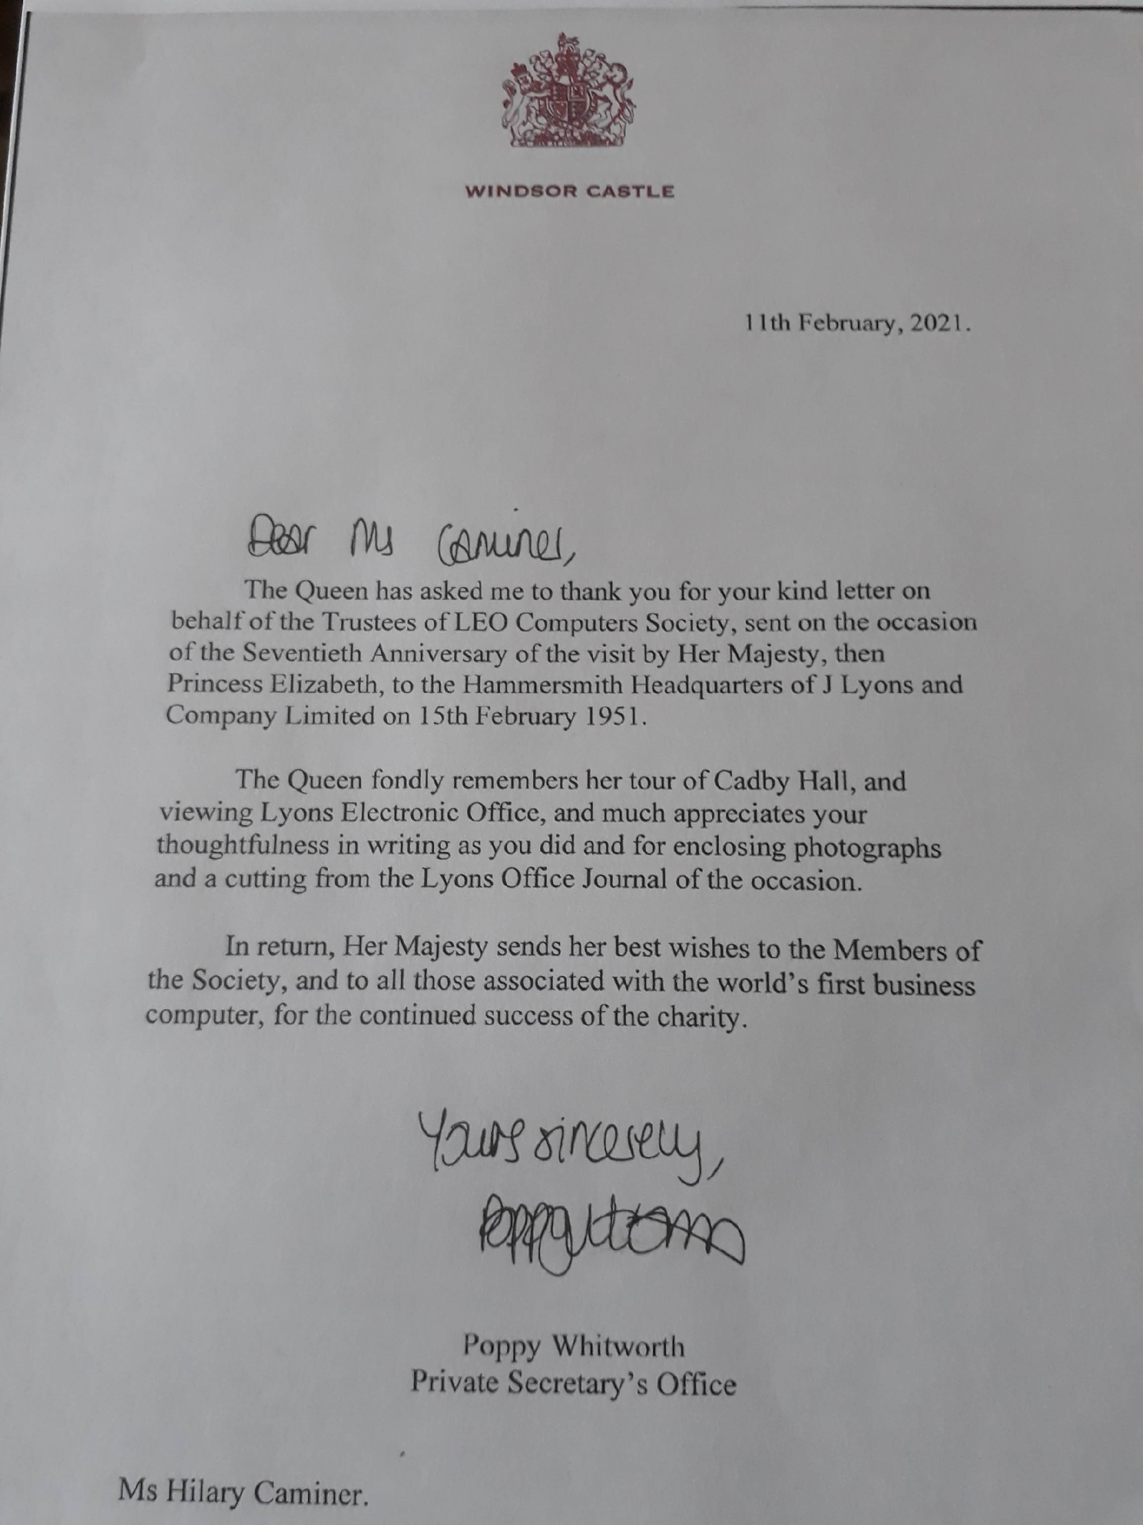

Slide 73
CAKES TO COMPUTERS
LEO
THE WORLD’S
FIRST
BUSINESS COMPUTER

Slide 74
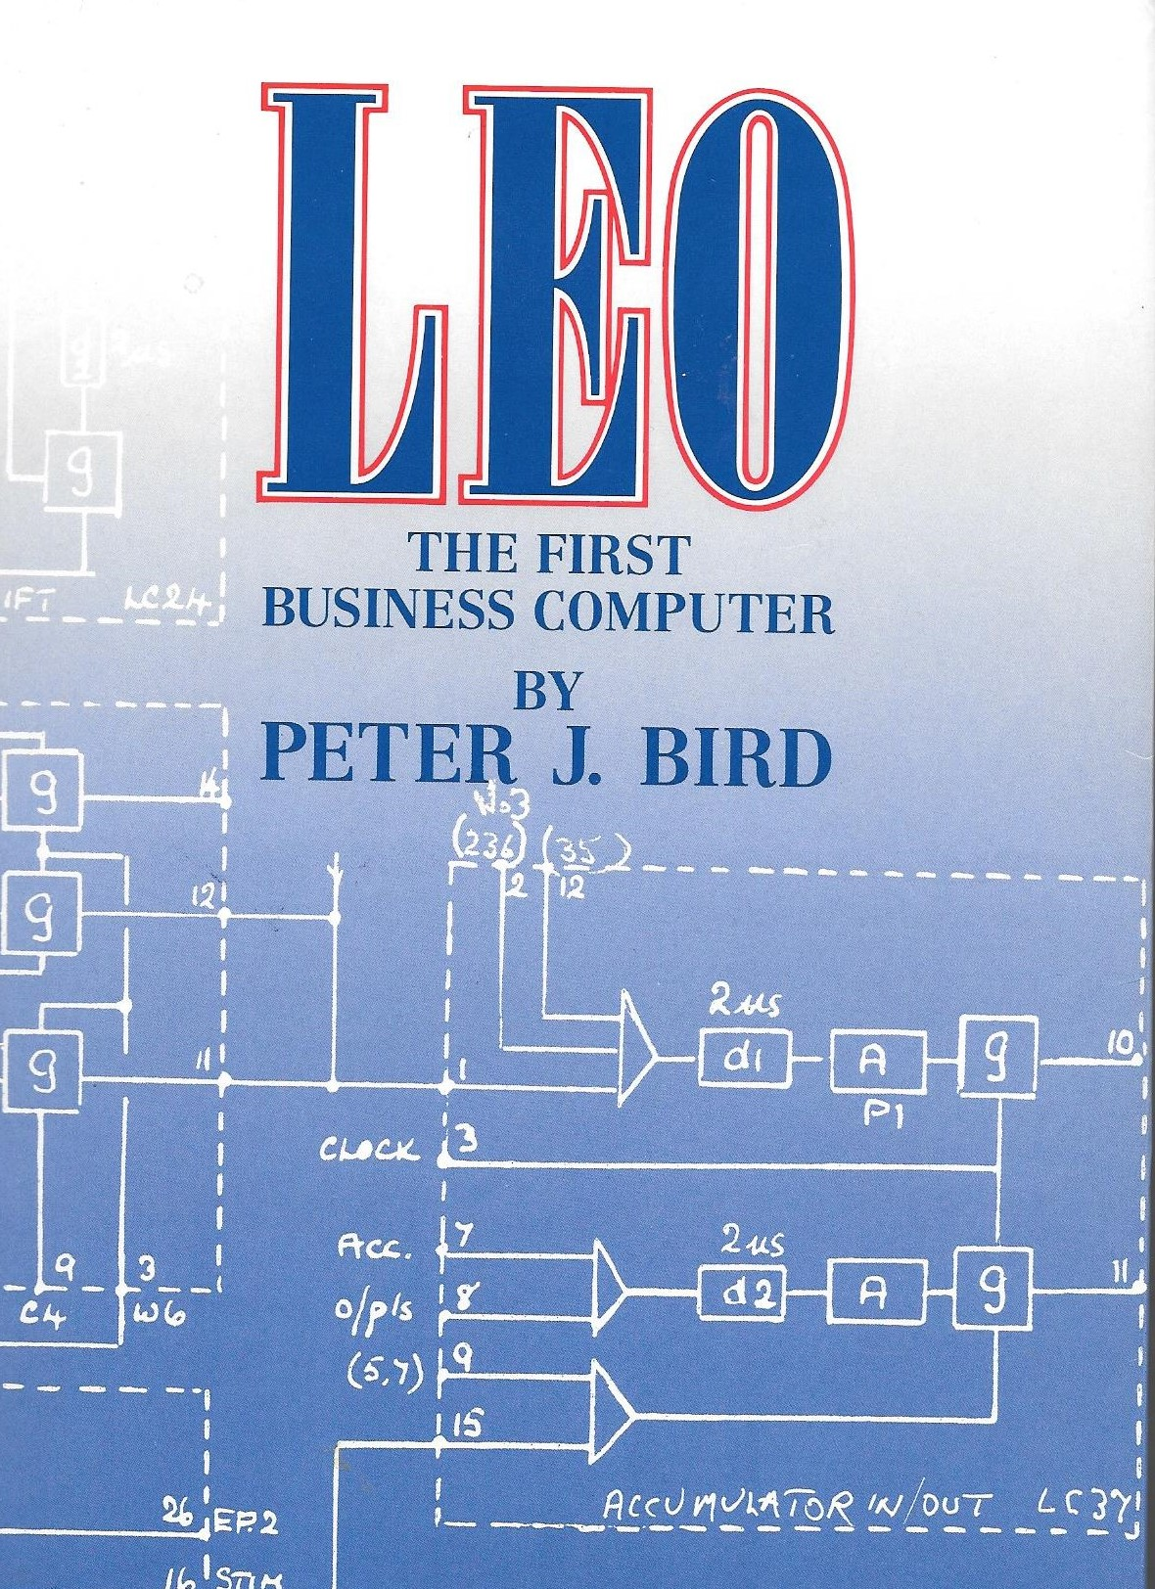
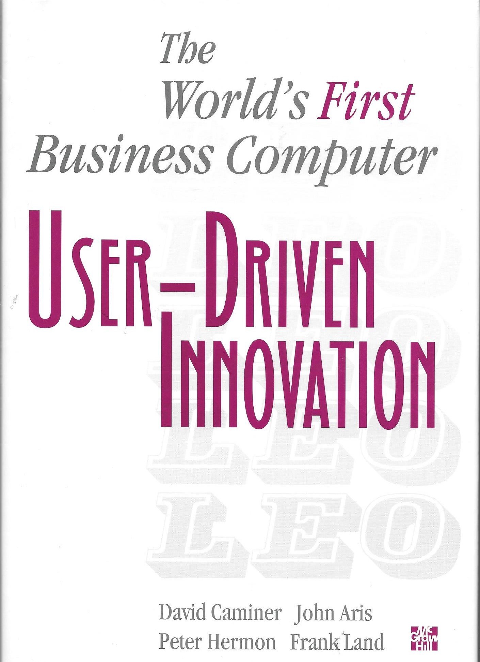
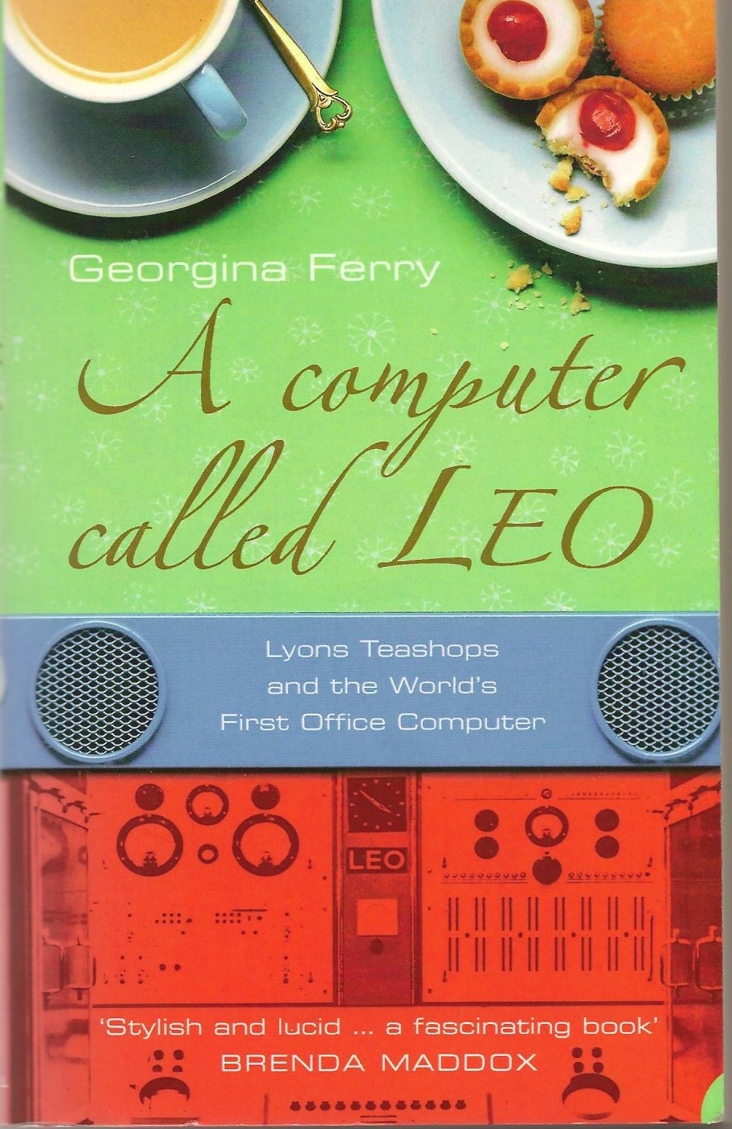
Some LEO Bibliography
LEO, the First Business Computer
Peter Bird.
Hasler Publishing, 1994.
User Driven Innovation
The world’s first business computer;
D.T. Caminer and others.
McGraw Hill, Maidenhead, 1996.
A Computer Called LEO
Georgina Ferry.
Fourth Estate, London, 2003.
Paperback edition Harper Perennial, 2005

